Slide 1

Different Computer Applications
By Farjan Ahmmed

Slide 2

WORD PROCESSING SOFTWARE AND ITS USE

Slide 3

Definition of Word Processing Software
Word processing software is a kind of software that use to create documents using computer.

Slide 4



Uses Of Word Processing Software
Editing
Typing
Creating Document

Slide 5
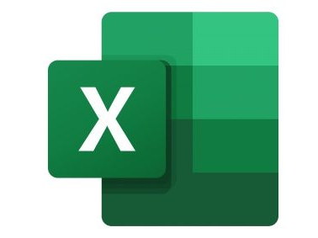

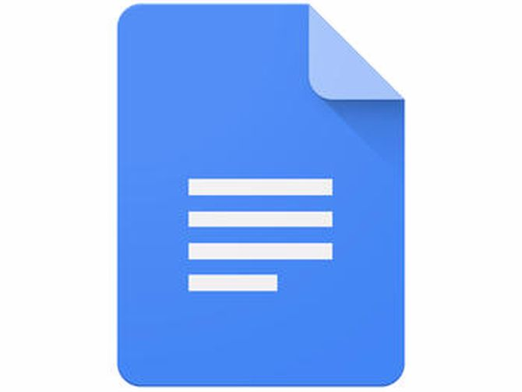
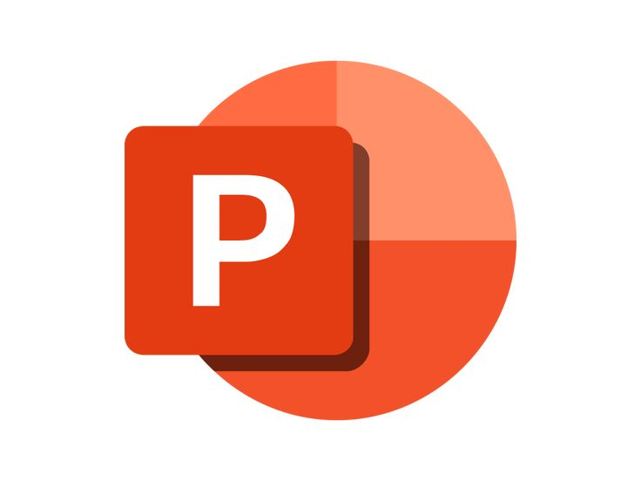


Microsoft Word
Most Popular Word Processing Software
Microsoft XL
Google Docs
PowerPoint
WPS Office
Notion

Slide 6

Spreadsheet Software And It’s Application

Slide 7

DEFINITION OF SPREADSHEET SOFTWARE
SPREADSHEET SOFTWARE IS A TYPE OF COMPUTER APPLICATION THAT ALLOWS USERS TO CREATE, MANIPULATE, AND ANALYZE NUMERICAL DATA IN A TABULAR FORMAT.

Slide 8




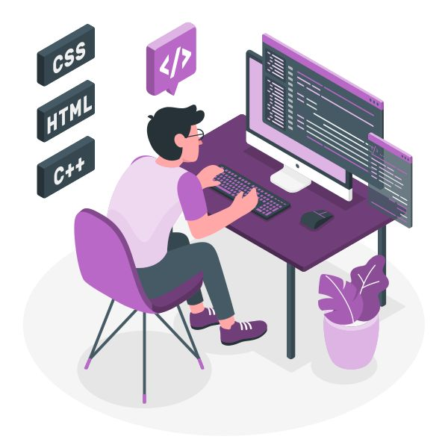
USES OF SPREADSHEET SOFTWARE
FINANCIAL MODELING
DATA ANALYSIS
It's widely used in finance for tasks like budgeting, financial forecasting, and creating financial models.
You can perform various types of data analysis in Excel, including sorting, filtering, and creating pivot tables to summarize and visualize data.
CHARTING AND GRAPHING​
BASIC PROGRAMMING
Excel enables you to create various types of charts and graphs to visualize data trends and patterns.​
Excel supports macros and VBA (Visual Basic for Applications) for automating tasks and creating custom functions.

Slide 9
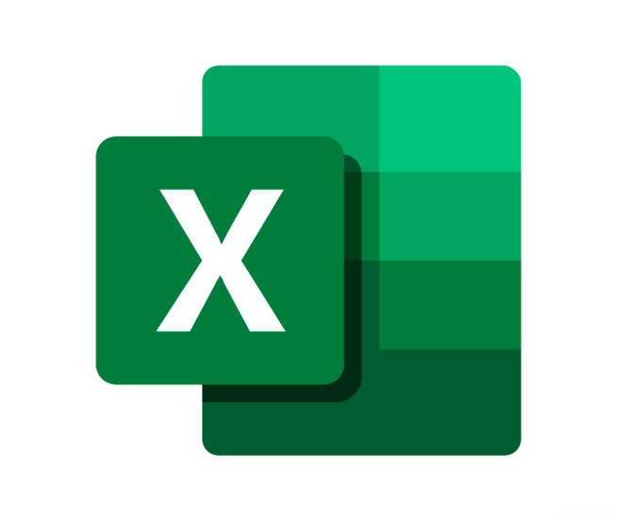
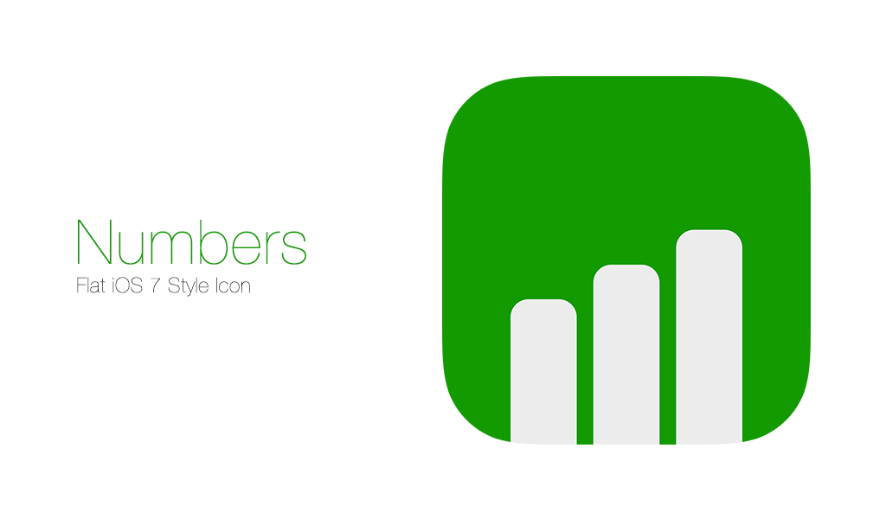

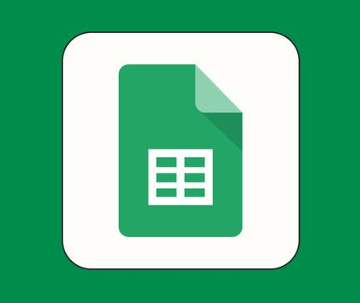

POPULAR SOFTWARE FOR SPREADSHEET
MICROSOFT EXCEL
APPLE NUMBERS
One of the most popular software for spreadsheet
Numbers is Apple's spreadsheet software.​
GOOGLE SHEETS​​
AIRTABLE
Most used spreadsheet software after Google Sheet​
Airtable combines the features of a spreadsheet with a database.

Slide 10



Graphic Design
Software

Slide 11

Definition of Graphic Design Software.
Graphic design software refers to computer applications and tools which are designed for creating, editing, and manipulating visual contents as per our desired needs.
‹#›

Slide 12








Uses Of Graphic Design Software
Photo Editing
Games Design
Use for cropping, color adjustment, lightening etc.
Use for designing a game’s visual.
Web Design
Post Design
Use for designing web for more user friendly look.
Use for designing social media posts.
Logo Design
Architectural Visual
Use for designing logo or icon for a brand or an organization.
Use for designing realistic renderings of buildings and architectural spaces.
Design A Product
Educational Materials
Use for designing any product like t-shirts, mugs, frame, stickers etc.
Use for creating visuals for textbooks, edu websites, and e-learning platforms.

Slide 13
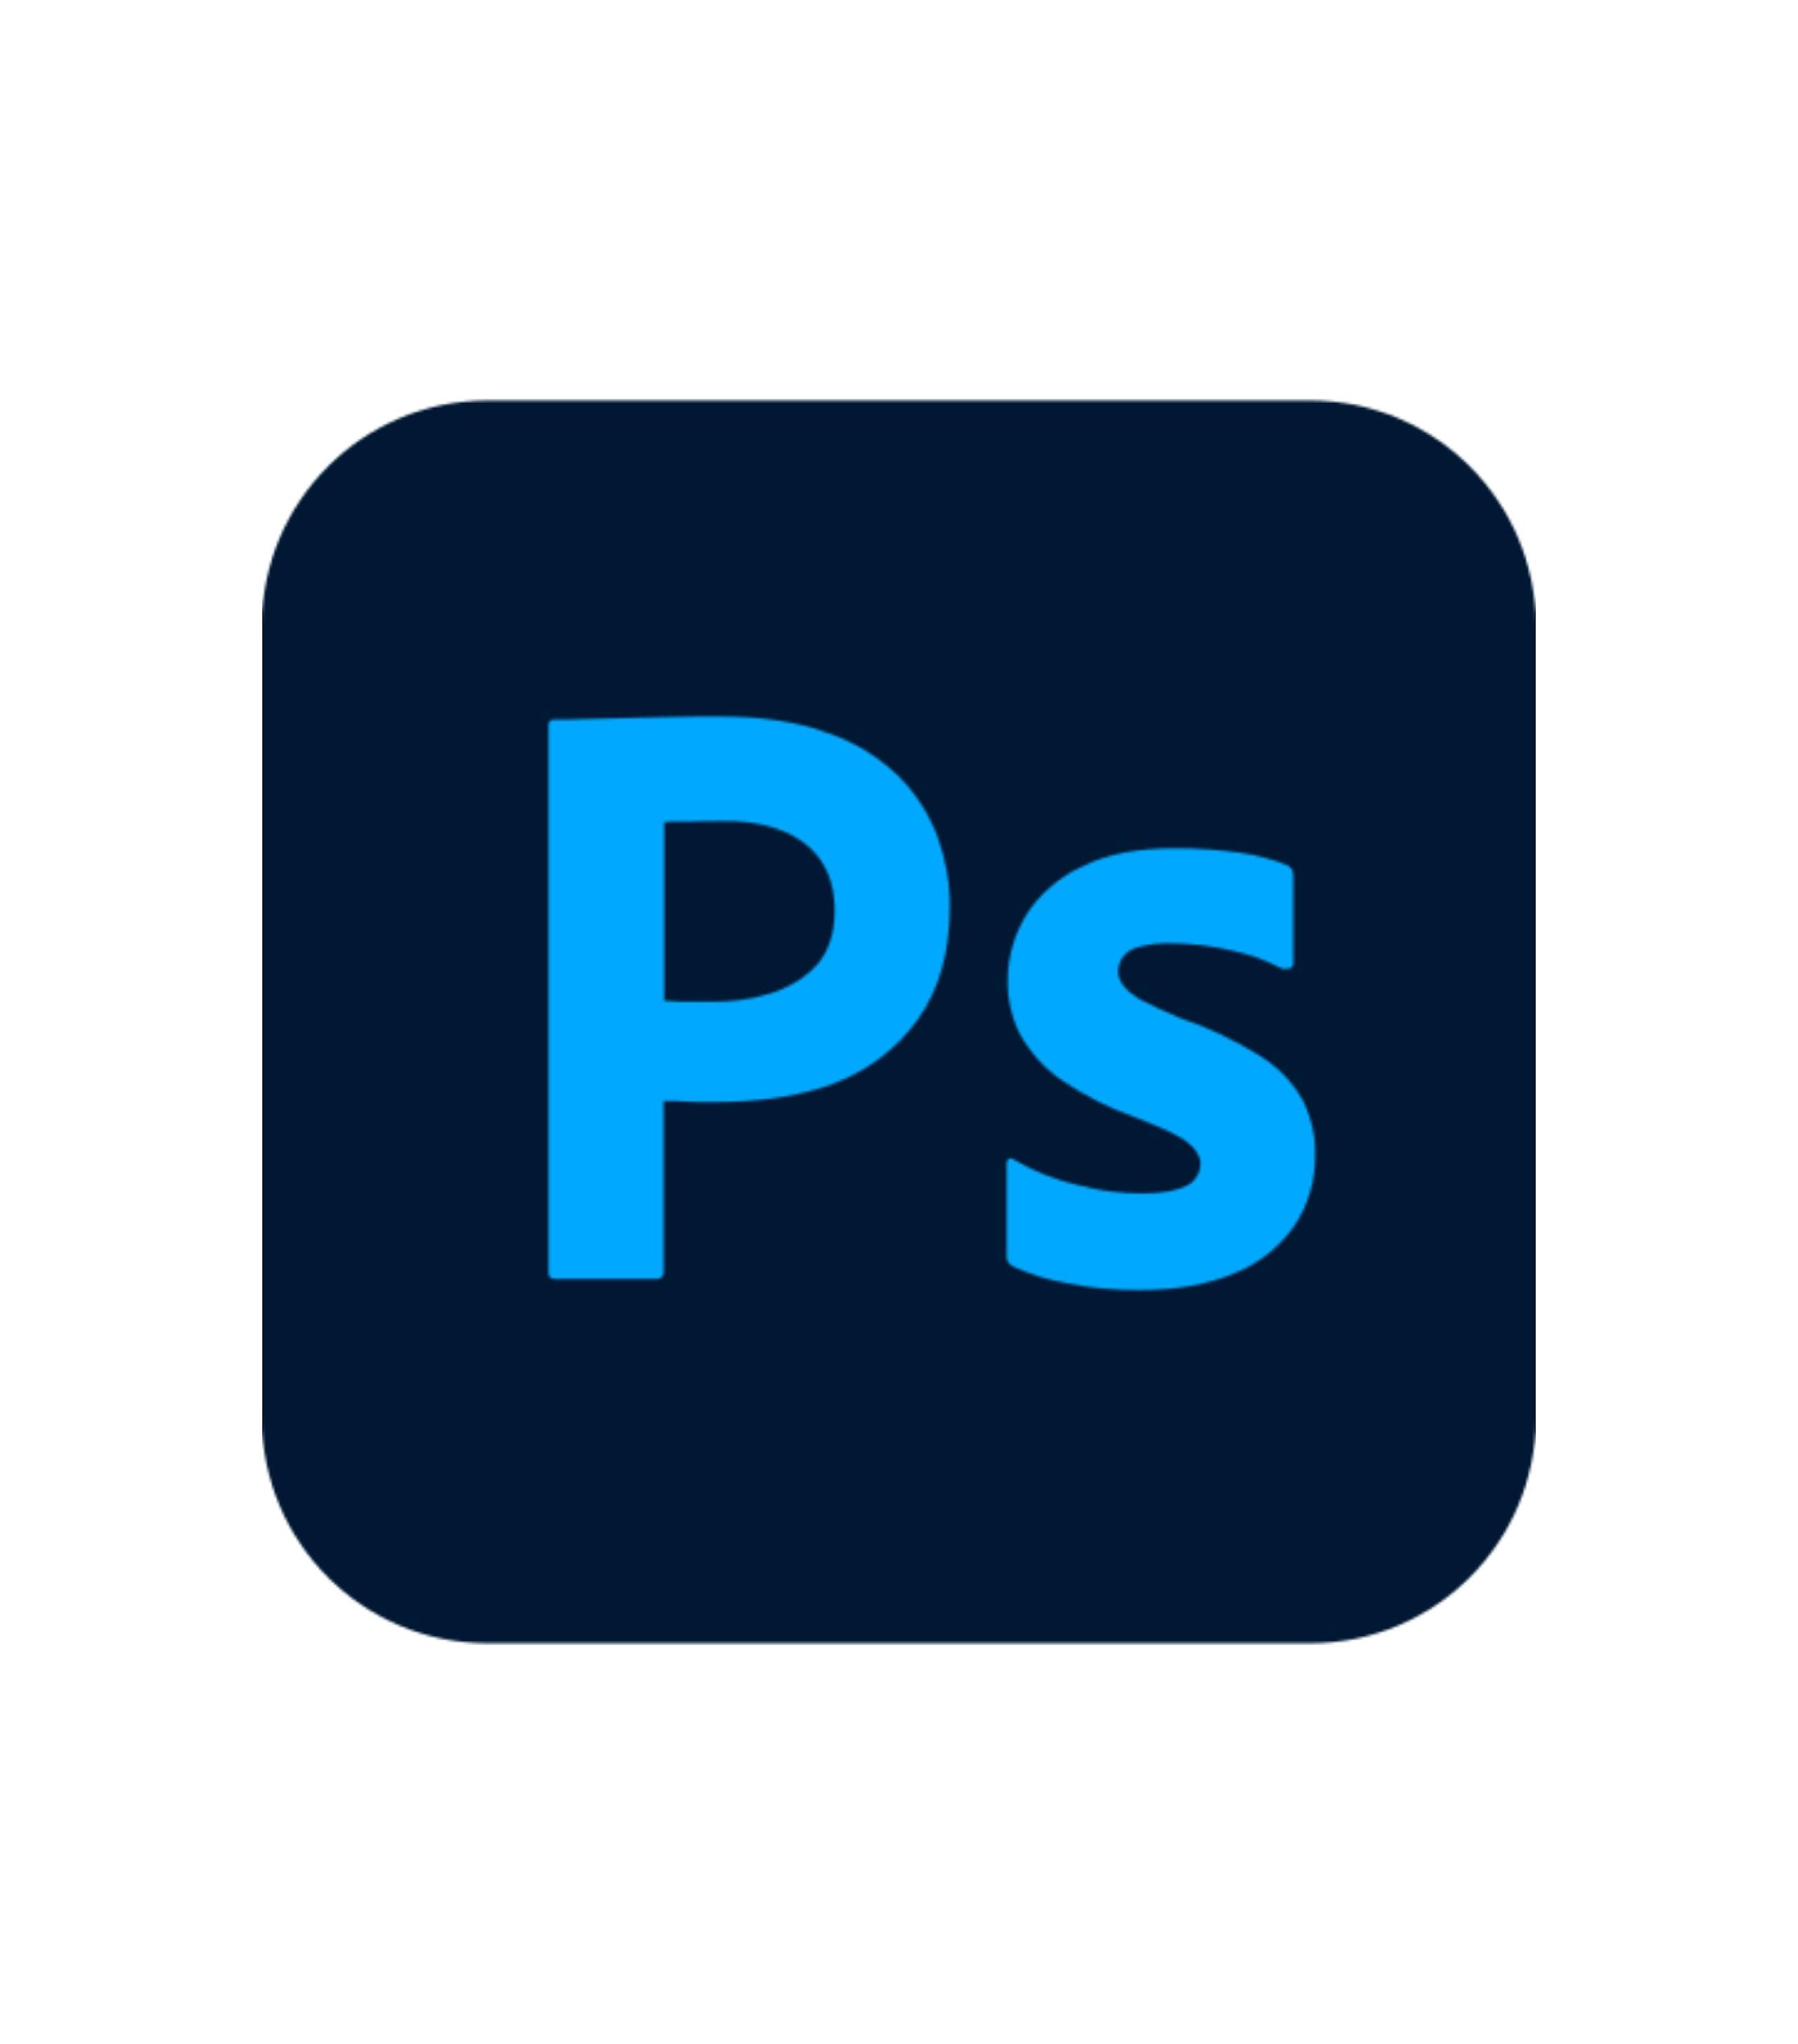


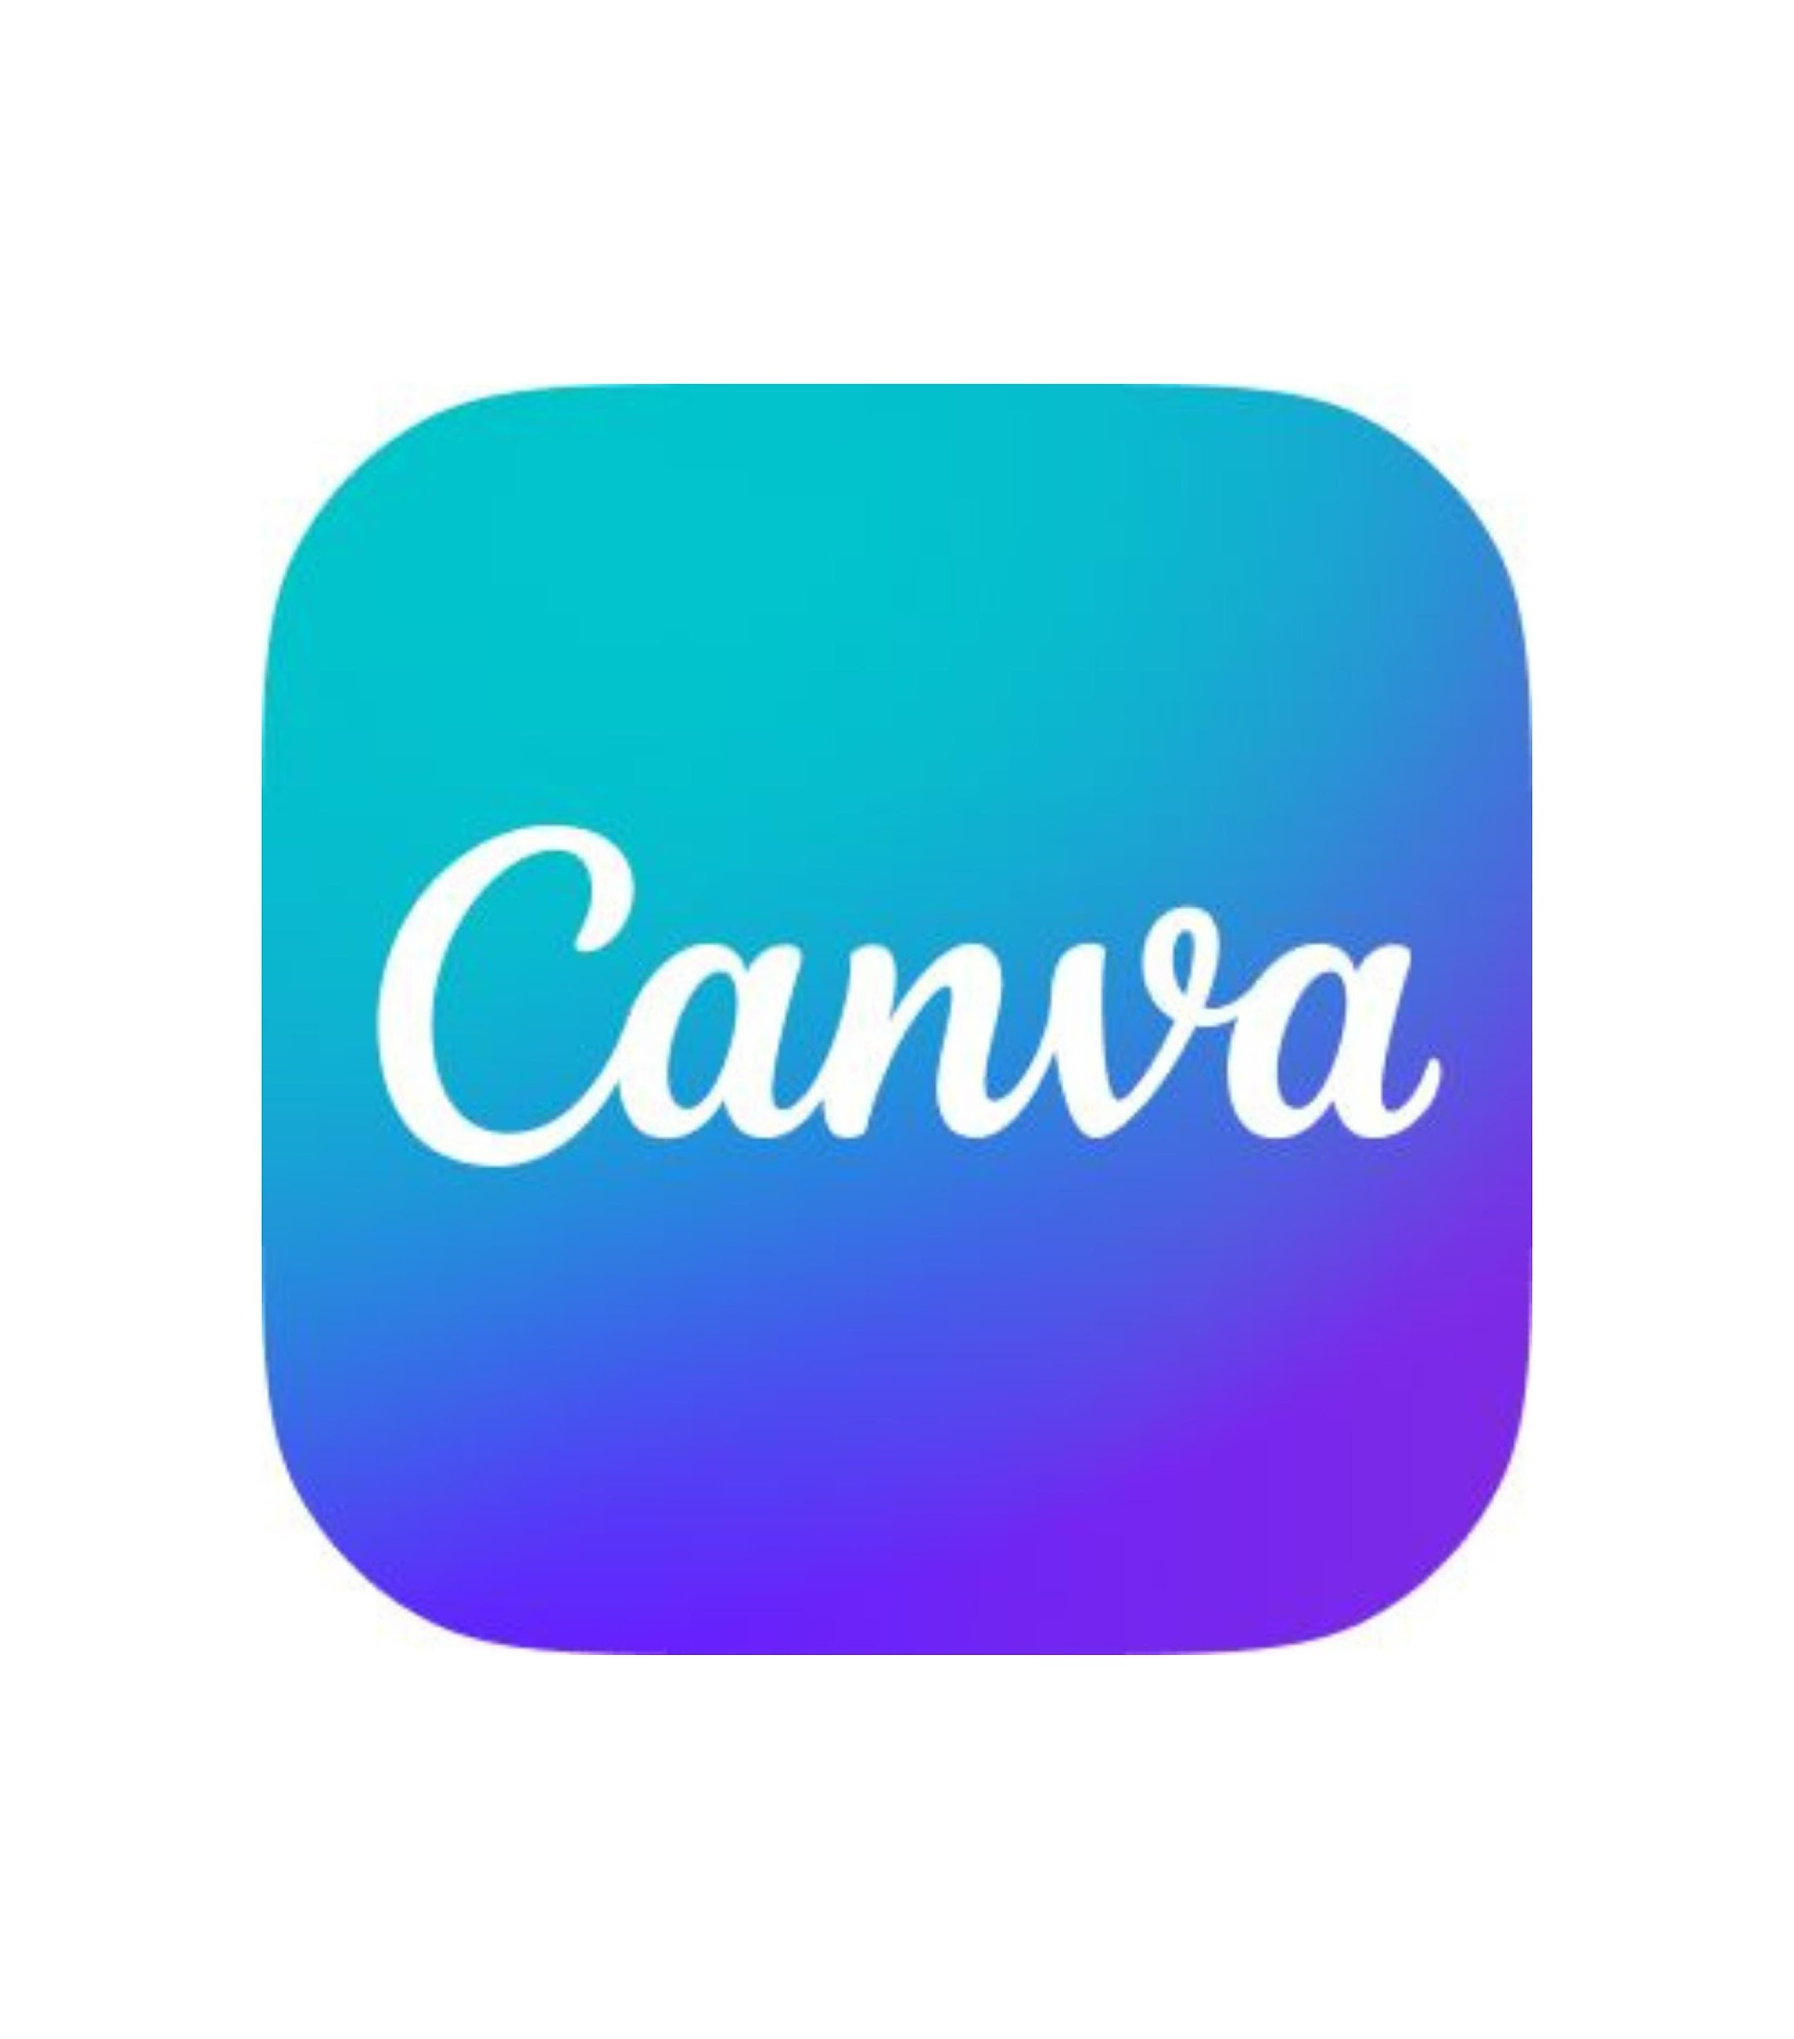

Popular Software For Graphic Design
Photoshop
Adobe
Figma
Figma Inc
Illustrator
Adobe
Canva
Canva Inc
Procreate
Savage Interactive
For editing photos or images.
For UX design and vector design.
For creating vector illustration.
For creating posters, banners and social media posts.
For drawing and arts.

Slide 14

Video Editing

Slide 15
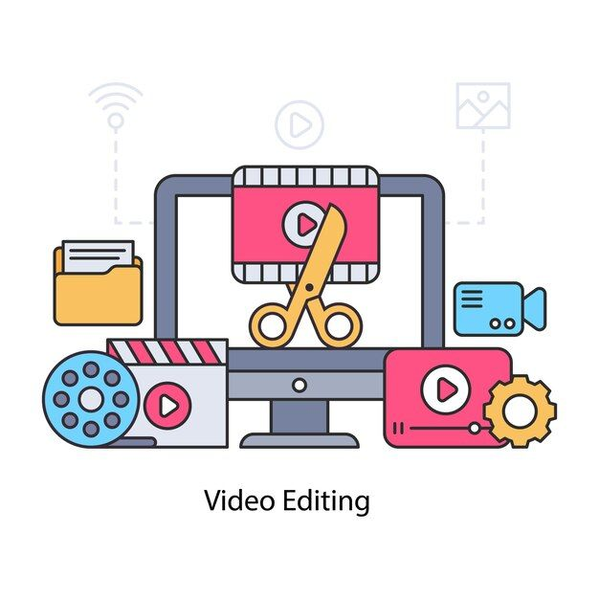
Definition
Video editing is the process of arranging and modifying video clips, audio, and effects to create a cohesive and visually appealing video.

Slide 16


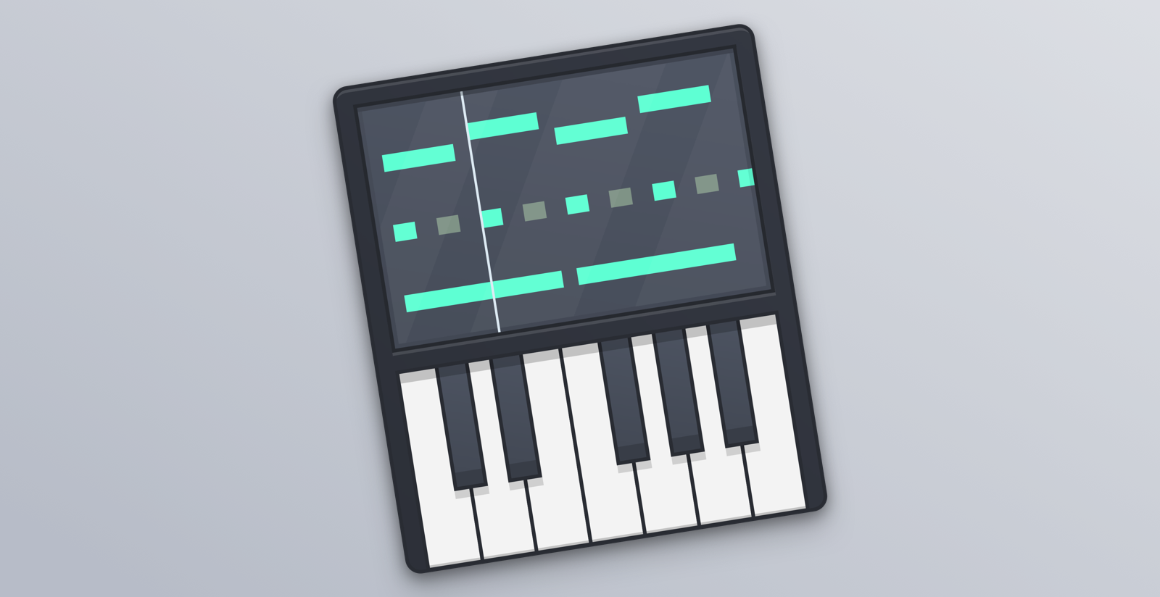
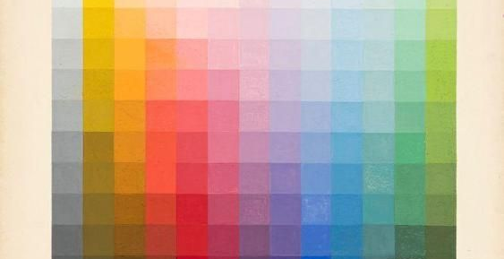




Uses Of Video Editing Software
Video Trimming
Transitions
Audio Editing
Color Correction
Use for cutting out mistakes, long pauses, or irrelevant content.
It cuts, fades, dissolves, wipes, and more, which help maintain viewer engagement.
They may also remove background noise and improve audio quality.
It adjust brightness, contrast, saturation, and color balance to achieve the desired look and feel.
Use for the incorporation of visual effects, such as CGI, motion tracking, and more.
Use for selecting the best shots and arranging them in the desired order to tell a coherent story.
Adding text, titles, graphics, and subtitles, set context, or provide additional details to the viewer.
Editors make necessary revisions based on feedback until the final version is approved.
VFX
Assembly
Titles and Graphics
Review and Feedback

Slide 17

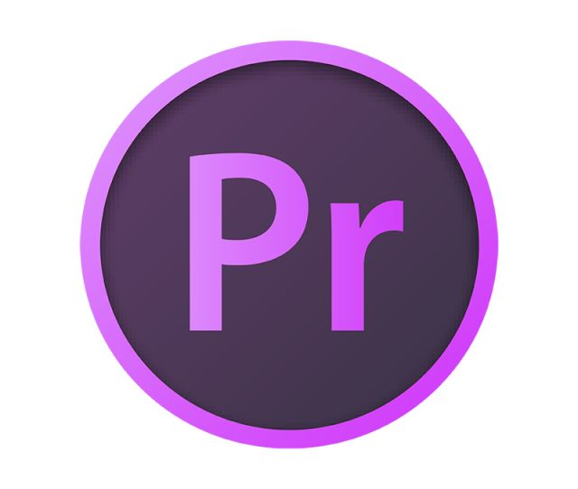


Popular Software For Graphic Design
Filmora
Premier
Sony Vegas Pro
Canva
A beginner-friendly video editing software
Most used software for video editing.
Known for its user-friendly interface and robust features
Also For creating Shorts, video edit.

Slide 18
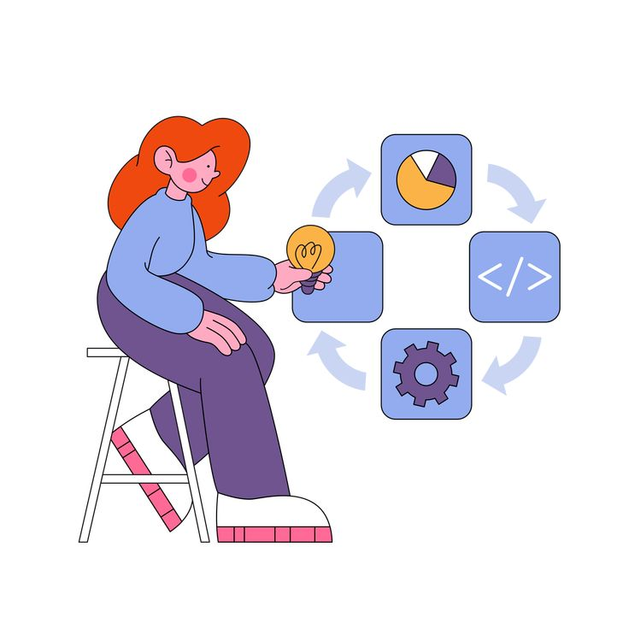
PROJECT MANAGEMENT AND COLLABORATION TOOLS

Slide 19

DEFINITION OF PROJECT MANAGEMENT TOOLS
Project management tools are software applications or platforms designed to assist individuals and teams in planning, organizing, executing, and tracking projects from initiation to completion.

Slide 20

ESSENTIAL FEATURES OF A PROJECT MANAGEMENT TOOL
Real-Time reporting
Simple to use
Customizable
API integration
Collaboration
Risk analysis

Slide 21




SOME OF PROJECT MANAGEMENT TOOLS
Monday.com
Trello
Jira Software
Asana
Release : 2012
Used by more than 90000 teams
Release : 2011
Used by over 50 million people
Release : 2002
Used by over 65000 customers
Release: 2008
Used by over 140000 Companies
Features :
Easy Collaboration
Highly customizable
Excellent for analytics
Features :
Smooth editing
High security standards
Easy data searching techniques
Features :
Agile reporting
Bug tracking
Used through Mobile application
Features :
Incredible task management
Privacy controls
Easy progress tracking

Slide 22
Thank You

